Slide 1



KS3 Mathematics
S7 Measuring Angles
Notes:
The aim of this unit is to teach pupils to:
Use units of measurement to measure, estimate, calculate and solve problems in a range of contexts; convert between metric units and know rough metric equivalents of common imperial measures
Extend the range of measures used to measure angles and bearings
Material in this unit is linked to the Key Stage 3 Framework supplement of examples pp 228-233.

Slide 2


Measuring angles
An angle is a measure of turn and is usually measured in degrees.
A full turn measures 360°.
360°
Notes:
Links:
S1 Line and angles – calculating angles.
S6 Construction and loci – drawing angles.

Slide 3
Measuring angles
An angle is a measure of turn and is usually measured in degrees.
A quarter turn measures 90°.
It is called a right angle.
90°
We label a right angle with a small square.
Notes:
Links:
S1 Line and angles – calculating angles.
S6 Construction and loci – drawing angles.

Slide 4
Measuring angles
An angle is a measure of turn and is usually measured in degrees.
A half turn measures 180°.
180°
This is a straight line.
Notes:
Links:
S1 Line and angles – calculating angles.
S6 Construction and loci – drawing angles.

Slide 5
Measuring angles
An angle is a measure of turn and is usually measured in degrees.
A three-quarter turn measures 270°.
270°
Notes:
Links:
S1 Line and angles – calculating angles.
S6 Construction and loci – drawing angles.

Slide 6
Acute, obtuse and reflex angles
All angles are acute, obtuse or reflex.
An acute angle is between 0º and 90º.
An obtuse angle is between 90º and 180º.
An reflex angle is between 180º and 360º.
Notes:
Pupils should be able to classify angles according to whether they are acute, right angle, obtuse, straight lines or reflex.

Slide 7
Acute, obtuse and reflex angles
Look at each interior angle in this shape. Is it acute, obtuse or reflex?
B
D
C
A
I
F
E
H
G
Notes:
Establish that A is acute, B is obtuse, C is reflex, D is acute, E is acute, F is reflex, G is acute, H is obtuse and I is reflex.

Slide 8
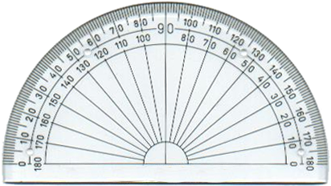
Using a protractor
We measure angles with a protractor.
Notice that the protractor has two scales.
Before you measure an angle decide whether it is acute or obtuse.
Notes:
Discuss the two scales on the protractor. The outside scale goes from 0° to 180° and the inner scale goes from 180° to 0°.

